Slide 1

U.S. Chronic Disease Indicators Overview, Gender Gap, and State Comparison
Project 1, Data Analysis by Abdalla Ashi , Najwa Hubail & Zainab Laith
Pt 10 – Aug 2025

Slide 2
Introduction
This analysis draws on the U.S. Chronic Disease Indicators (CDI), a standardized dataset developed by the CDC’s Division of Population Health in collaboration with the Council of State and Territorial Epidemiologists and the National Association of Chronic Disease Directors. The CDI provides consistent definitions and reporting for 115 health indicators, enabling uniform collection and comparison of chronic disease data across states and territories.

Slide 3
Analysis Objectives
Chronic Disease Mortality – Underlying Cause (U.S.) Examine national-level mortality patterns to identify the leading causes of death from chronic diseases.
Gender Gap in Chronic Disease Mortality (U.S.) Compare mortality rates between males and females to highlight disparities and potential gender-related health priorities.
State Comparison in Chronic Disease Mortality (U.S.) Analyze how mortality rates vary across states to uncover geographic disparities and inform targeted public health interventions.

Slide 4
Data Description
Source: U.S. Chronic Disease Indicators (CDI)
Number of rows: 309,215
Number of columns: 34
Total missing values (NaN): 3,953,604
Completely empty columns: 10
Time coverage: multiple-years span between (2015-2022)
Geographic coverage: All U.S. states and territories

Slide 5
Data Problems
Nan Values
Variations in Question values
Variations in population groups
Mixed indicator types
Multiple measurement units in (DataValueUnit)
Mixed locations (individual states vs. overall U.S.)

Slide 6
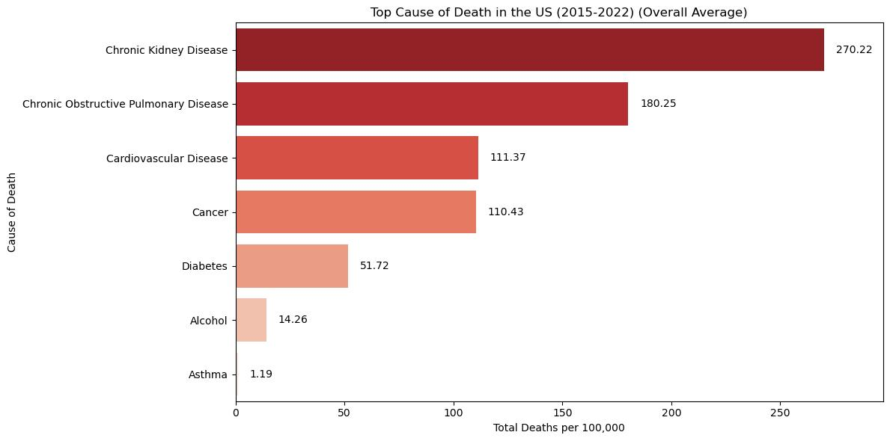
Q1 - What is the top cause of mortality in the U.S. ?

Slide 7
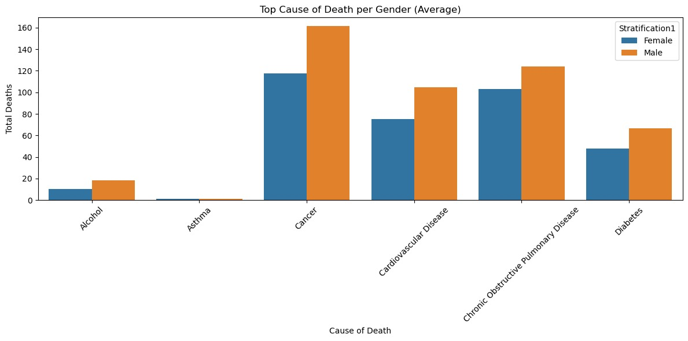
Q2 - What is the average gender gap in chronic disease mortality?

Slide 8
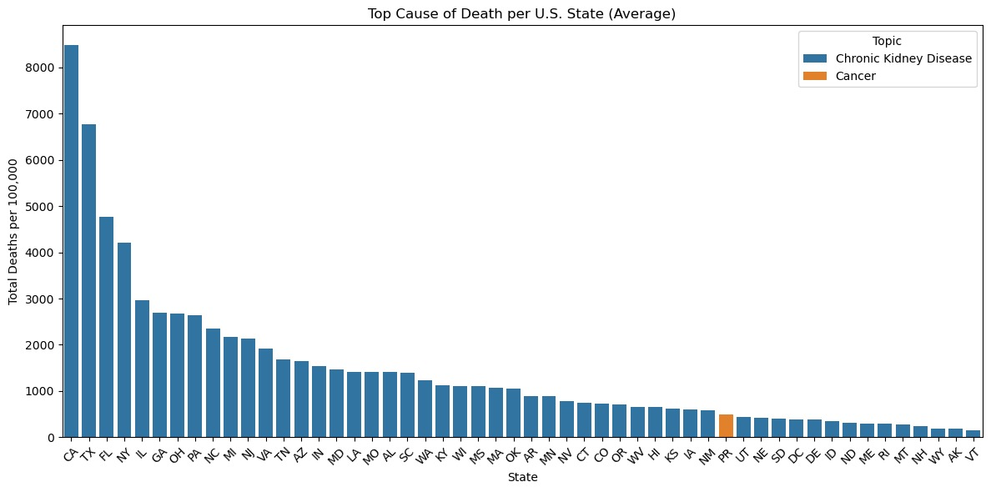
Q3 - What is the average state-level chronic disease mortality?

Slide 9
Key Findings
The top cause of mortility in US is Chronic Kidney Diseases.
Males have more percentage of mortlity in almost all chronic disease.
The top cause of mortility in all US states is Chronic Kidney Diseases except in once state (PR).

